Slide 1

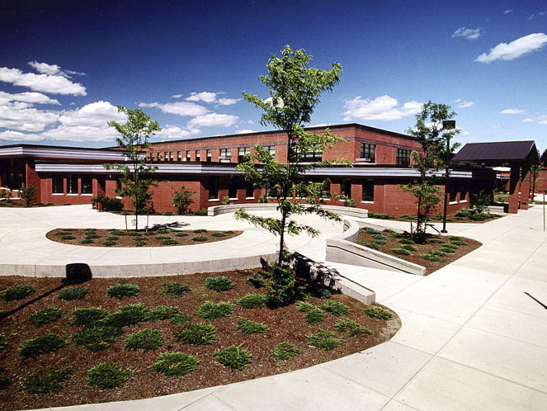


Where students succeed
Notes:
Welcome to Rock Pic Private School, where students succeed.

Slide 2
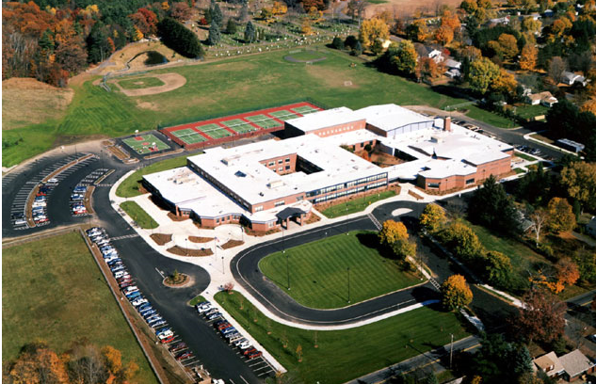
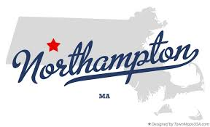

Northampton, Mass.
92% Graduation rates
75% college bound
Notes:
Rock Pic Private School is located in beautiful Northampton Massachussetts, and has been ranked #1 within private schools here. Our graduation rates are among the highest in Massachussetts, and over 75% of our students are college bound.

Slide 3

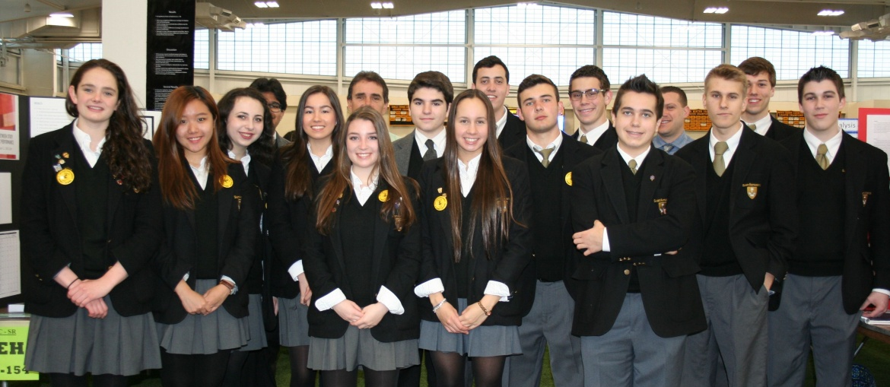

In-state
Out-of-state
On-campus
online
Notes:
Rock Pic Private School enrolls students, both in-state and out-of-state, grades 9-12 who want to gain the most out of their education. We offer on-campus and online options for classes, all taught by our top notch staff specializing in their area of teaching.

Slide 4

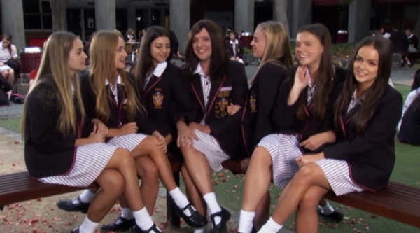
Northampton, Mass.
123-456-7890
www.rockpic-private.edu
Notes:
Our staff encourages innovative learning and friendship while striving for the success of all students. To learn more about Rock Pic Private School and all it has to offer, please go to our website or call our enrollment representatives directly. Rock Pic Private School could be where your student succeeds.

