Slide 1
Combined course projects
Jamie Steppat
W5A2
Notes:
This presentation will have all the course projects combined that pertain to Fiona’s Flowers and Gardening.

Slide 2
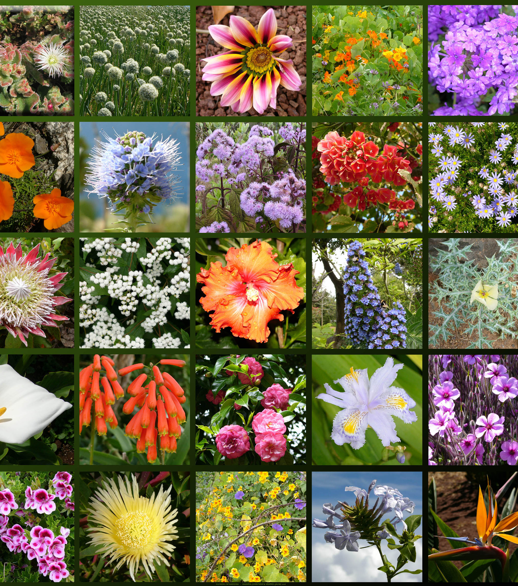
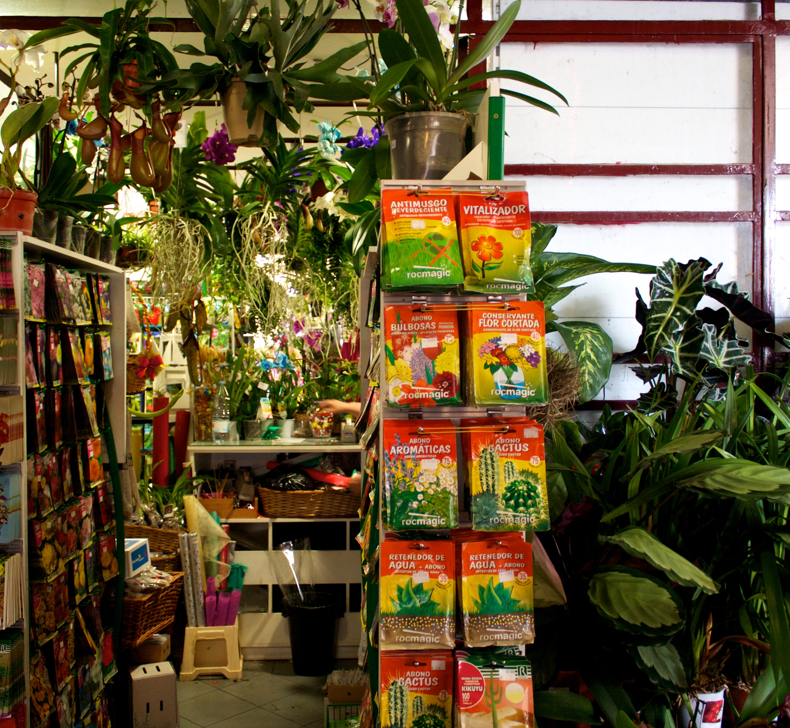
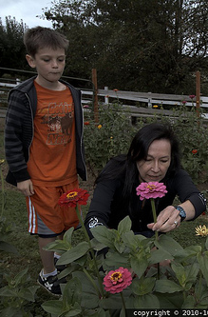
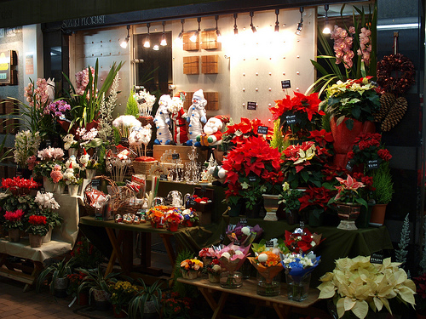
Fiona’s Flowers and Gardening
Brand
Fiona’s Flowers and Gardening is a company owed by Fiona Violet, she has one location in Daisy, MN.
The store carries pre-arranged bouquets, individual flowers, vases, gardening tools, flower seeds and food.
There is a small garden out back of the store where customers can pick their own flowers.
Notes:
First we will discuss what type of business Fiona’s is and what she is trying to accomplish through advertising. Fiona’s Flowers and Gardening is a company that is owned by Fiona Violet. She has been working with flower arrangements and gardening for over 15 years. Her only location is in Daisy, MN where she sells individual flowers, bouquets, basket arrangements, vases, gardening tools and supplies, flower seeds and food. In addition to the small store, Jane has a garden behind the store she personally attends too, filled with all kinds of different flowers! The flowers in the back garden are available for customer picking for a small extra charge.

Slide 3
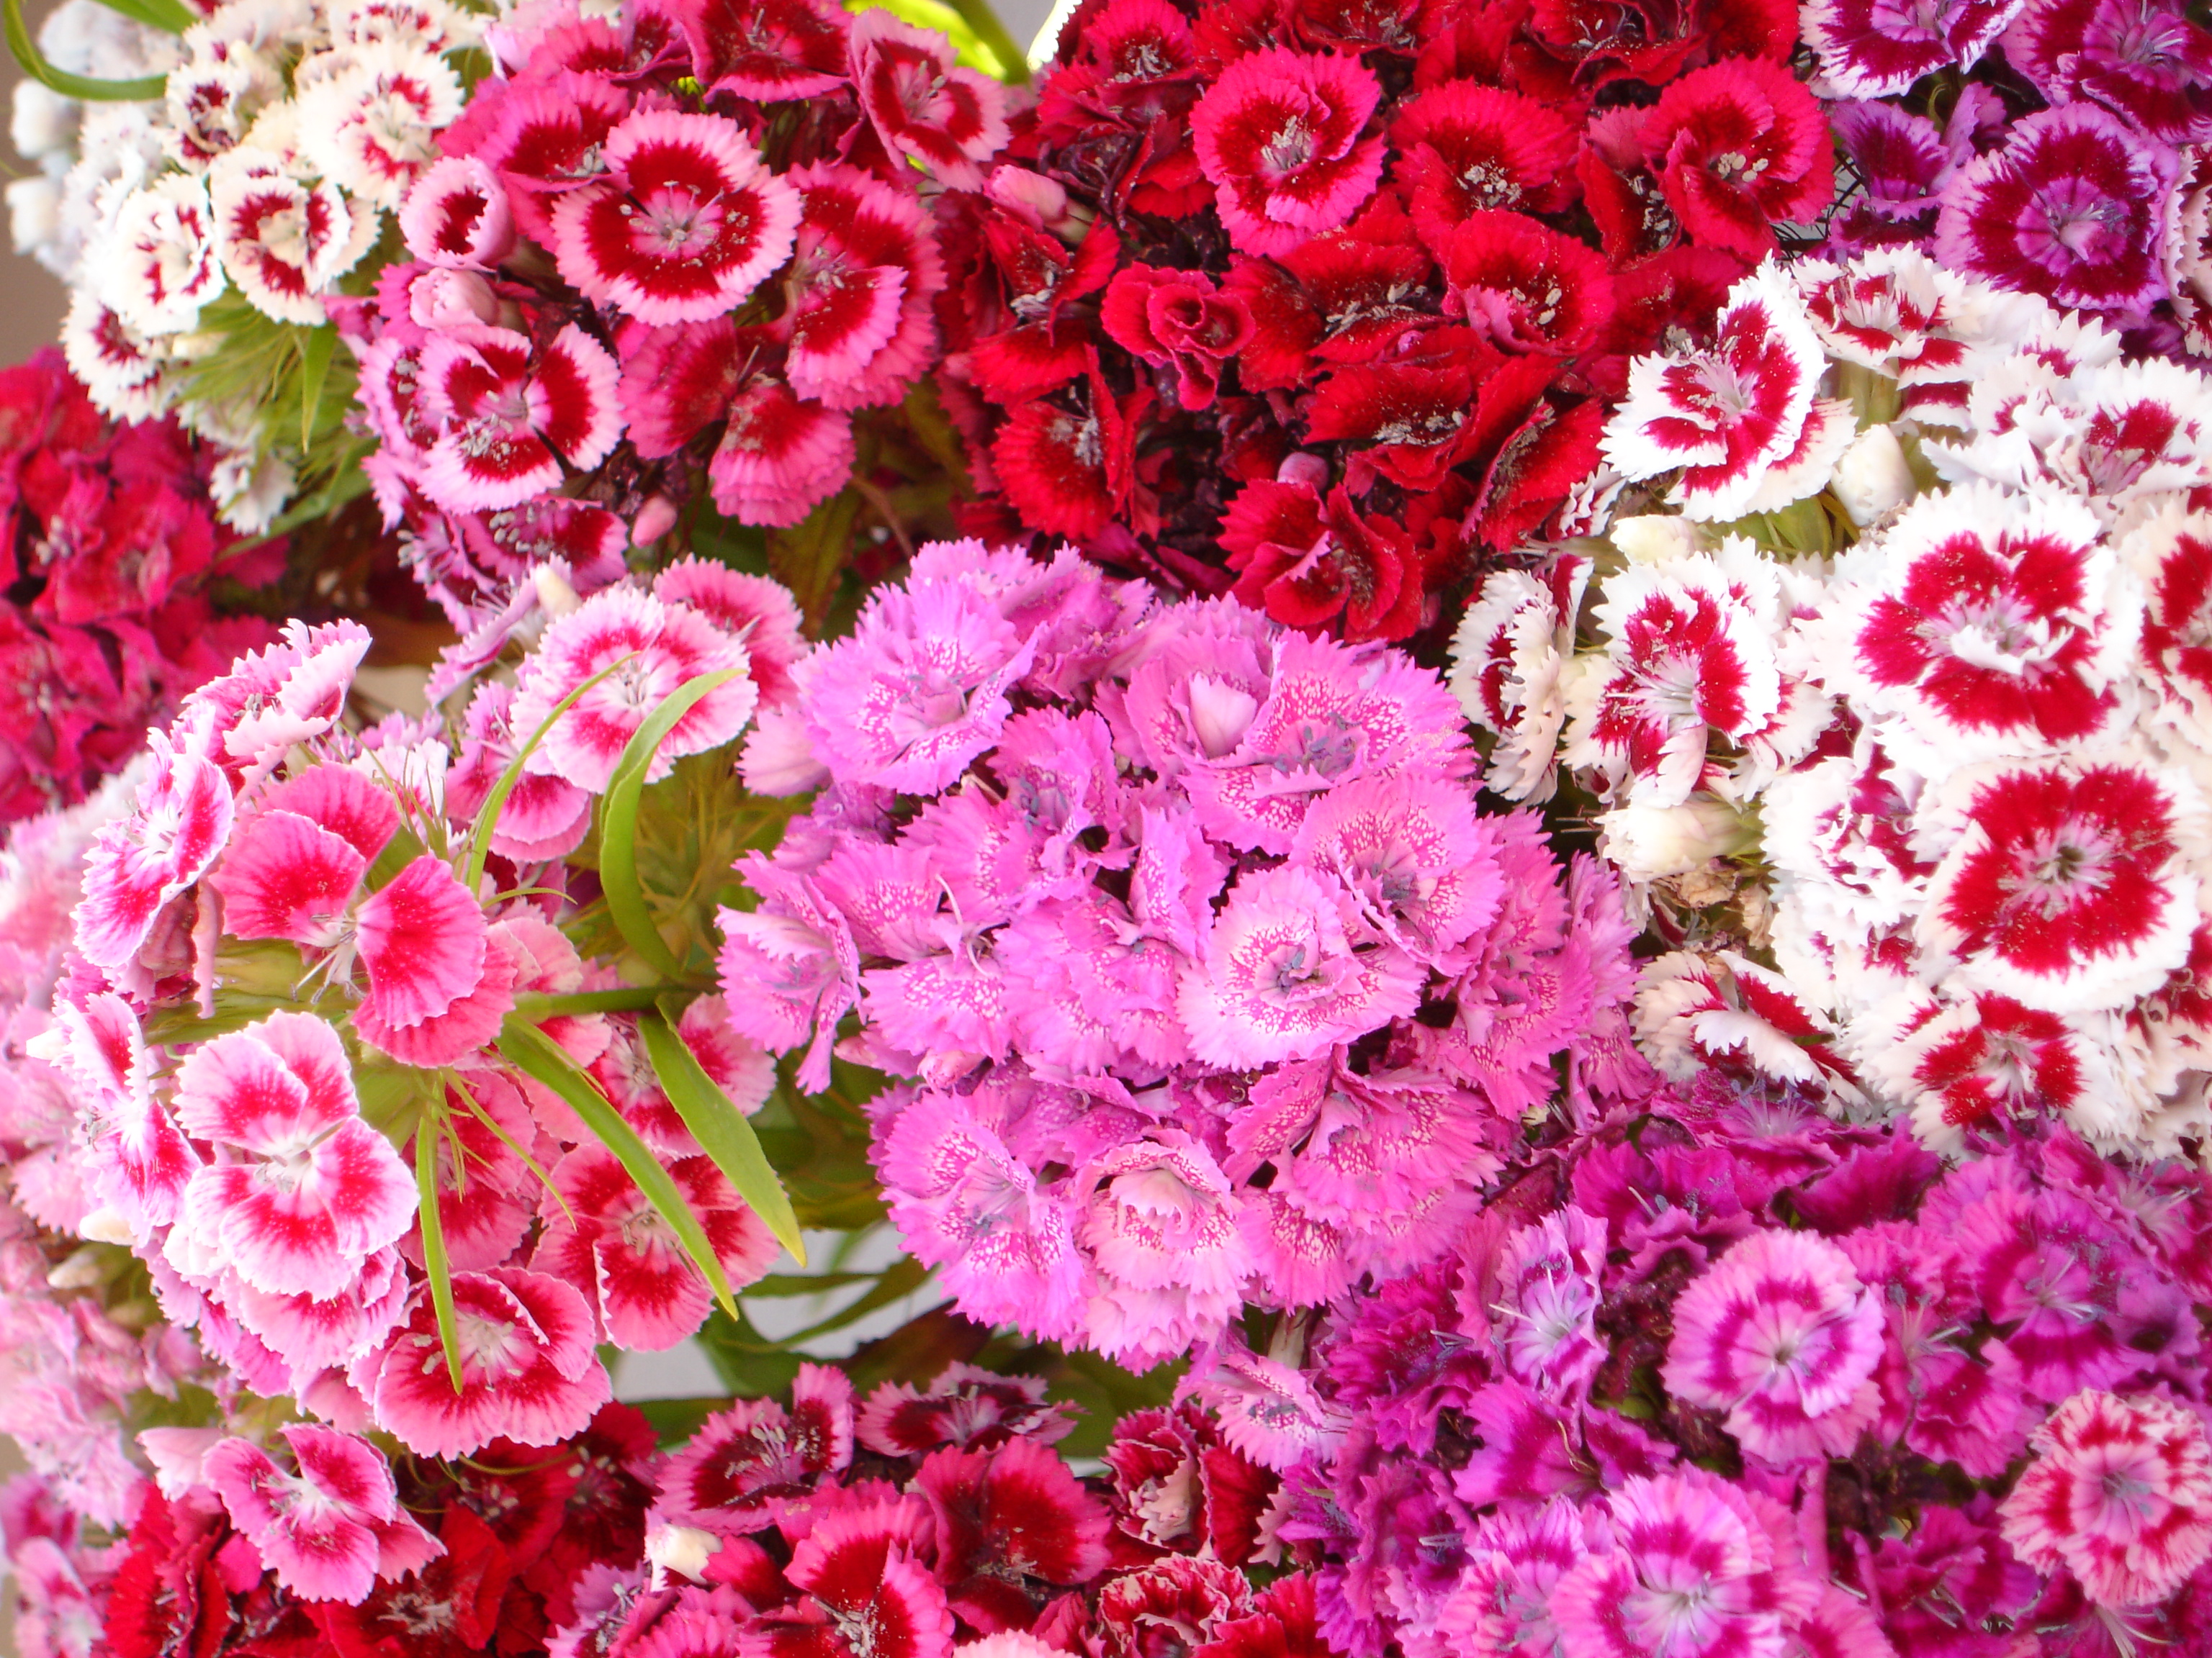
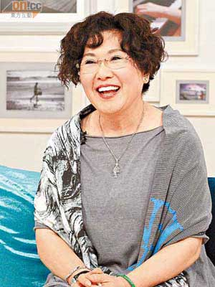


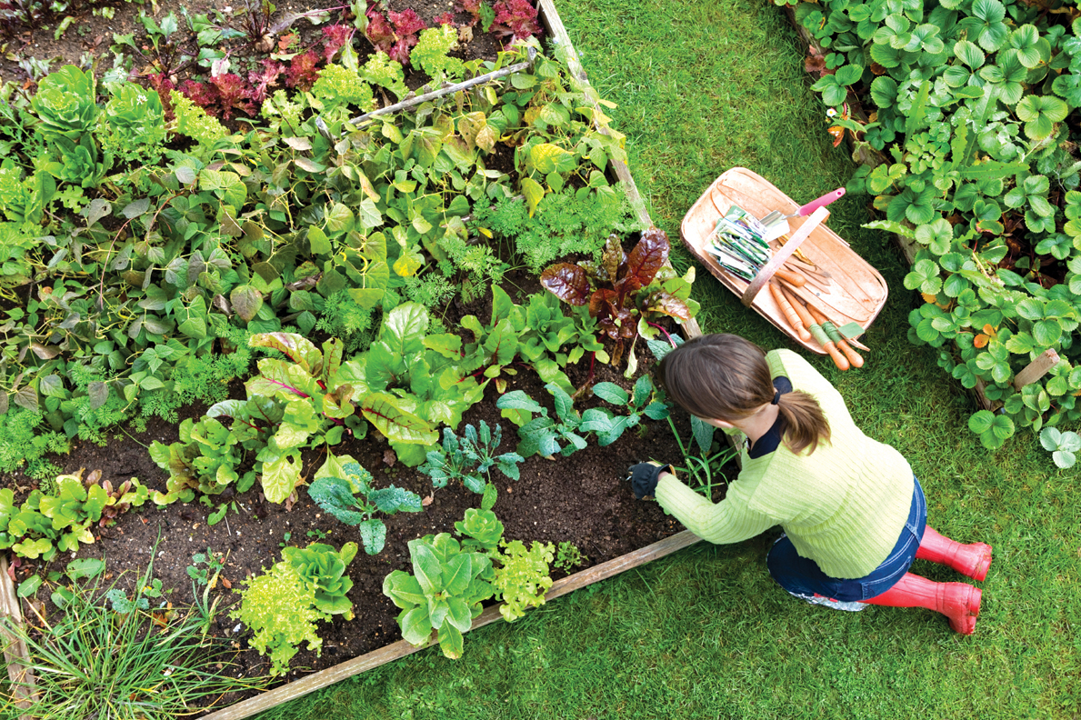

Fiona’s Flowers and Gardening
Target Market
Target Market includes:
  Women
  Ages 40-55
  Married
  A degree beyond high school
  35,000-50,000/year
  Enjoys outdoors and gardening
  Creative and outgoing
Notes:
Fiona currently does all of her own advertising, along with her target market research. She is currently targeting women who are in their 40’s to 50’s. These women are either married or have been married, obtain a degree beyond high school, and are making a yearly income of 35-50 thousand. The women Fiona is targeting should also enjoy the outdoors, being active and gardening. Personality wise, these women should be creative, outgoing, and charismatic.

Slide 4
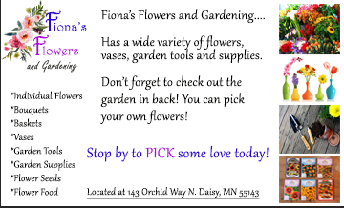
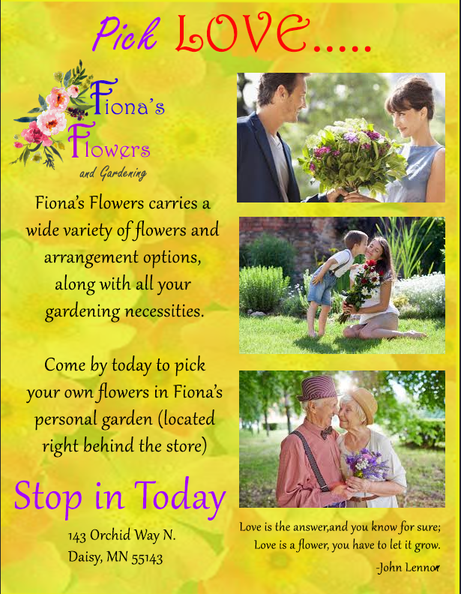
Fiona’s Flowers and Gardening
Current Advertising
Flyer
Bright Colors
Easy to Read
Photographs
Logo
Address
Explanation of Products
Newspaper Ad
Simple
Logo
Address
Explanation of Products
Photographs
Notes:
As mentioned before, Fiona does all of her own advertising. The first advertisement is a flyer that she has posted locally around the town of Daisy. This flyer has a lot of bright colors making it very eye catching. The text is different in contrast and easy to read, important information such as products, name, logo and address are listed as well. The photographs used on the flyer gain an emotional tie to the viewer, along with the quote about love and flowers.

Slide 5
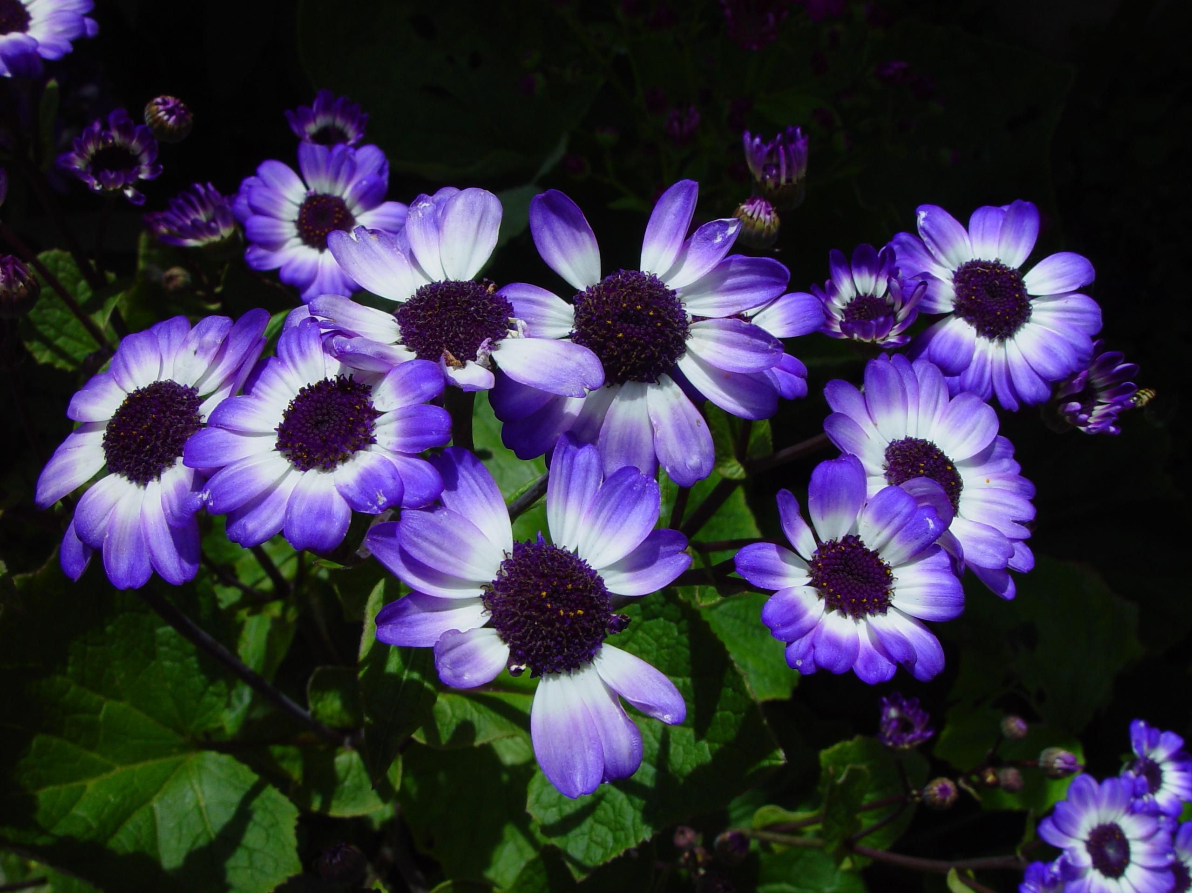
Fiona’s Flowers and Gardening
Inconsistency?
Fonts
Photographs in the first ad
Notes:
Between the two ads most of the look is consistent. The first ad does have an extra font used and the color red, however it fits within the ad because of the Love word. The photographs in the first ad also are giving more of the impression Fiona’s Flowers just has flowers, there is no clue within the images that they sell gardening tools and supplies or vases.

Slide 6
Fiona’s Flowers and Gardening
Failure to Reach Target Market?
Different Photographs
More focus on the garden
Focus on garden supplies
Add a photograph of the flowers available for sale
Notes:
I believe the ads here will reach the target market, however I think there are some improvements that can be made for them to reach even more potential customers. The first ad could replace a couple photographs with one featuring the garden tools and supplies and the other showing off the garden behind the store. Having a bit more focus on the products that are available in store and the flower varieties that are in the garden could also benefit the company.

Slide 7
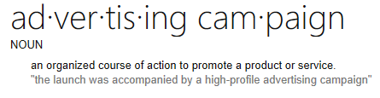
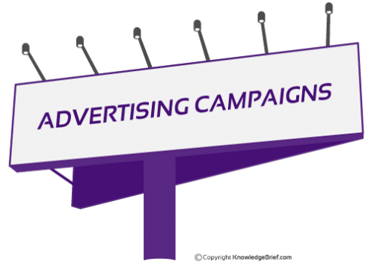
What is an Ad Campaign?
Series of linked advertisements
Single idea/theme
Several media channels
One brand
Target Market
Notes:
An advertising campaign is made up of advertisements from different forms of media that all have the same theme or message in mind. Usually advertising campaigns will cover one brand at a time and focus on the target market specific to that brand. All of the advertisements that are a part of an advertising campaign are linked in someway regardless of the media used, such as online, tv, radio, print, newspaper, billboard or magazines.

Slide 8

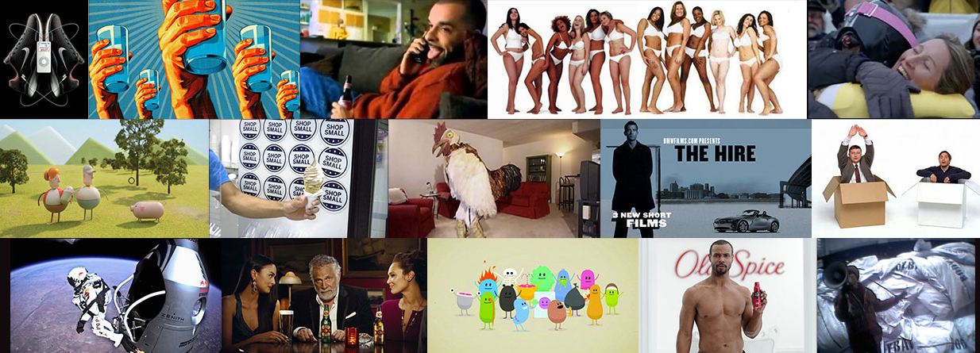
Examples of Ad Campaigns
Notes:
All the photographs in this slide are a part of AdAge’s 15 top Ad Campaigns of the 21st Century. These advertisements moved and motivated people, and were also creative and impactful. Starting at number 15, we have Unicef’s Tap Project, this campaign was simple; donate a dollar and help provide a child with drinking water for 40 days. Number 14 is Chipoltle’s Back to the Start, this was meant to be an introductory video for a new loyalty program that turned into an advertisement. Number 13 is Budweiser’s Whassup, this campaign I remember from my childhood. This single word catch phrase was used by many and became Budweiser’s rise to fame. Number 12 is Metro Trains Dumb Ways to Die, this included a catchy song and cute little cartoon characters. Number 11 is Dos Equis Most Interesting Man in the World, 10 is American Legacy’s Truth, 9 is Proctor and Gamble’s Thank You, Mom featuring a skier with chapped lips, even at an older age Mom’s are always there. Number 8 is Apple’s Get a Mac, 7 is American Express’ Small Business Saturday, 6 is Burger King’s Subservient Chicken, 5 is Red Bull’s Stratos, 4 is Old Spice’s The Man Your Man Could Smell Like. The top three advertising campaigns of the 21st century are……..BMW Films, The Hire, Nike Plus Running, and Dove’s Real Beauty.

Slide 9
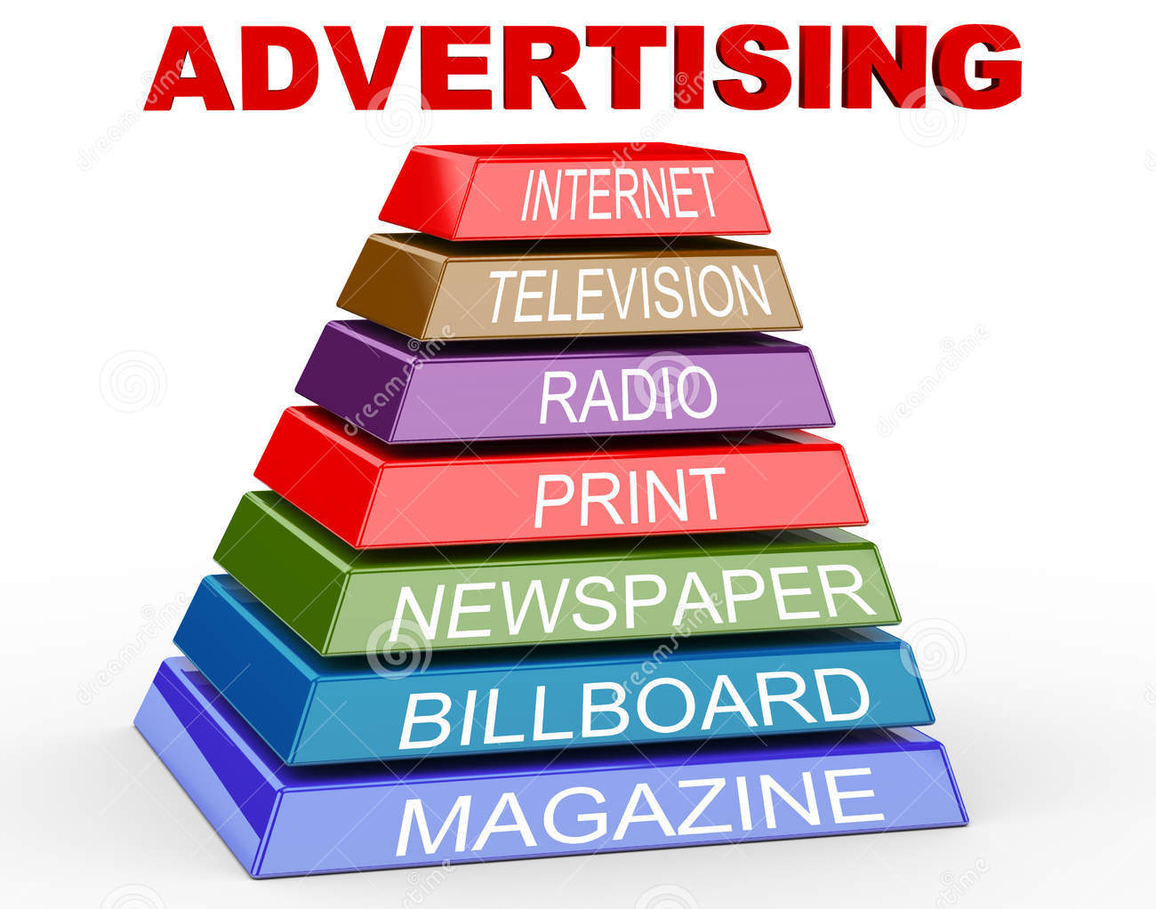
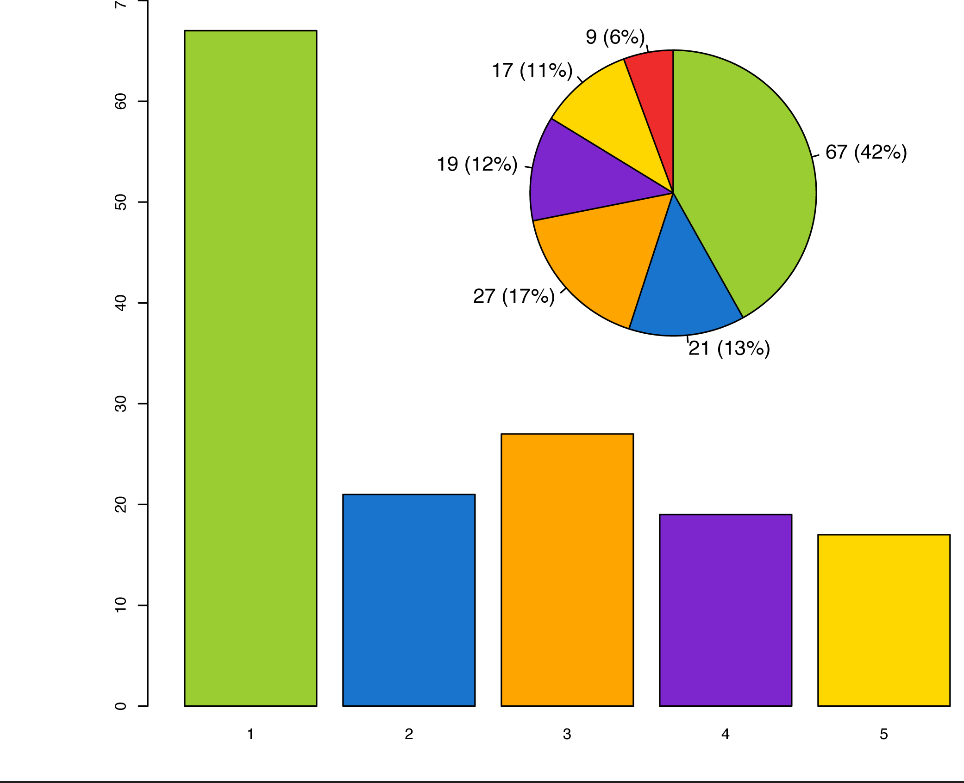
How do Campaigns Help Reach the Target Market?
Using appropriate media
Measuring the results
Adjustments
Frequency
Notes:
After the target market is identified, this is when the campaign can really start being creative and specific. Depending on who the target market is could change the form of media used. When researching your target market, research the type of media that is viewed most by that specific range of people. This will help slim down which media forms will be best for the selected target market. A great way to make sure of reaching your target market is using more than one form of media, this ensures your message is reaching not only your target market but others as well. Also with having a campaign you are able to measure the results of each advertisement and make adjustments if needed, once all adjustments have been made and the advertisement is finalized it can be published. Campaigns also can help out with the budget aspect and increasing the frequency of how often the advertisement is being aired.

Slide 10
Design Brief
Objectives
Promote and inform the public about the flower and gardening business.
Increase brand awareness.
Increase gardening supply sales.
Advertising Issues
Inconsistent
Images that represent Fiona’s
Pick Your Own garden
Notes:
The fonts used within the advertisements need to be consistant, along with the colors, logo and information. The photographs used should put focus on the flowers available, gardening supplies and the “Pick Your Own” garden in the back. Within the information provided on the advertisement, more focus should be put on the items for sale and the “Pick Your Own” garden. Fiona’s objectives are as follows:
1. Promote and inform the public about the flower and gardening business. Fiona’s Flowers could have 2 classes a month that teach about different flowers and the basics of gardening, this could be done over a 6 month span. Fiona’s could also have a youth night covering the basics of gardening and let the children walk through the “Pick Your Own” garden and chose one.
2. Increase brand awareness by 15% by publishing 2-3 advertisements every 4 months. These advertisements should use a variety of media and be able to engage the potential customer.
3. Increase gardening supply sales by 20% by having special deals, coupons and more advertising for these supplies.

Slide 11

Design Brief Cont.
Tone of Voice
  Simple
  Informative
  Creative
Target Audience
  Women
  40-55
  35k-45k/year
Target Market Statement
Notes:
Tone of Voice: The tone of voice for these advertisements are going to be simple and informative, yet creative and fun. We want the potential customer to learn about Fiona’s Flowers and Gardening, yet not get bored with a bunch of information, this is where the creative and fun photographs, sales and colors will come into play. There is not much change from the current advertisements besides making the fonts and colors consistent and easy to read, while also promoting gardening supplies and the “Pick Your Own” garden out back.
Target Audience: Women, ages 40-55, married with a degree beyond high school, income between 35,000-50,000/year. These women should enjoy the outdoors and gardening and have a creative and outgoing personality.
Target Market Statement: Fiona’s Flowers and Gardening wants to promote their brand to women who are 40-55 that have earned a degree beyond high school. These women would have an annual income of 35-50k and enjoy outdoor activities, such as gardening and camping.

Slide 12
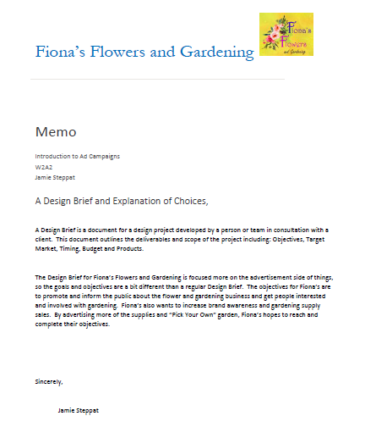
Memo
Notes:
This memo discusses what a design brief is and the explanation of choices that have been made. A Design Brief is a document for a design project developed by a person or team in consultation with a client. This document outlines the deliverables and scope of the project including: Objectives, Target Market, Timing, Budget and Products.
The Design Brief for Fiona’s Flowers and Gardening is focused more on the advertisement side of things, so the goals and objectives are a bit different than a regular Design Brief. The objectives for Fiona’s are to promote and inform the public about the flower and gardening business and get people interested and involved with gardening. Fiona’s also wants to increase brand awareness and gardening supply sales. By advertising more of the supplies and “Pick Your Own” garden, Fiona’s hopes to reach and complete their objectives.

Slide 13
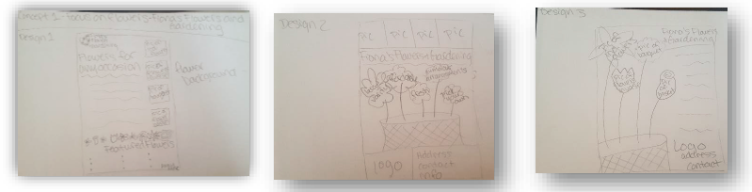
Concept 1-Focus on Flowers
Notes:
Concept 1 is focus on the flowers that are for sale within Fiona’s store. The first design has a handful of photographs featuring individual flowers, flowers in vases, flower bouquets and flower baskets. There is also a small list of the most common flowers that are for sale. The logo is at the top of the page along with little flower images as a border. The second design is featuring the flowers that are for sale within Fiona’s store, this design is more creative with the basket of flowers featuring positive key things about Fiona’s along with photographs of the flowers for sale along the top. The logo is located at the bottom this time along with address and contact information. The third design is sort of a combination of the first and second design, it has a bit of text along the right side, however there is the creative picture on the left side that will have the photographs of flowers within the flowers. The logo, contact and address stayed along the bottom.

Slide 14
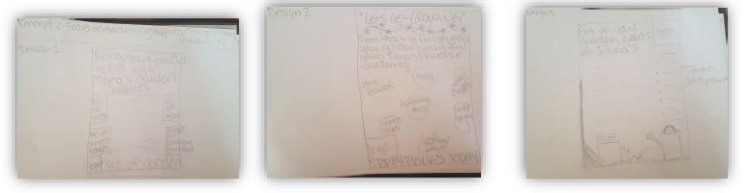
Concept 2-Focus on Gardening Supplies
Notes:
Concept 2 is focusing on all of the garden supplies Fiona has for sale within her store. This would include flower seeds, vases/baskets/pots, shovels/rakes and dirt/fertilizer and plant food. There are photographs of these items on both sides of this design, along with a photograph of Fiona’s personal garden at the bottom. The headlining text is big with a small amount of text below. The second design again is featuring the garden supplies for sale. It has a catchy headline and a call to action, the photographs are spread out across the middle of the page with a bit of text (information) above. The third design is also featuring the garden supplies for sale, there is a drawing of some of the supplies at the bottom of the page, a list of items on the right side and a bit of text below the headline.

Slide 15
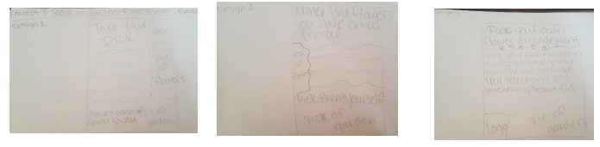
Concept 3-Focus on Garden
Notes:
Concept 3 is focusing on Fiona’s personal garden she has in the back of the store. These is a place where customers can have the experience of walking through a garden and picking their own flowers to buy. The first design is a photograph of the flower on the bottom of the page, a list of the flowers available to be picked and a catchy headline at the top. The second design is a lot simpler, again focusing on the garden out back. The headline text is large with a bit of text below, there is a line clarifying that you can pick these flowers yourself with a photograph of the garden. This is the last design focusing on the back garden, the headline uses big text with a short description below, the logo is in the bottom corner with a picture of the garden. This one is very simple.

Slide 16
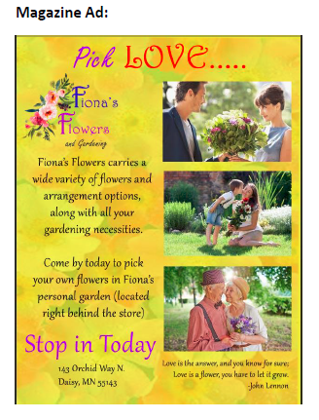
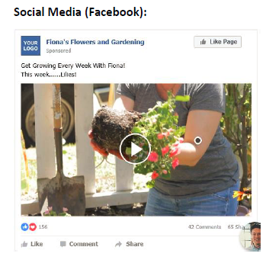
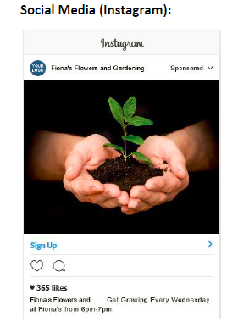
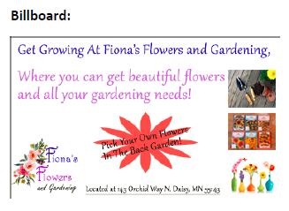
Media Choices
Campaigns
Media Used
Pricing
Notes:
There will be two campaigns Fiona’s is trying to advertise, “Pick Your Own” and “Let’s Get Growing” The Pick Your Own campaign will run for 5 months (mostly spring and summer) promoting Fiona’s personal garden behind the store. The Let’s Get Growing campaign will run for 4 months, promoting the basics of gardening and youth participation. The media used to promote these campaigns will be print (magazine and billboard) and social media. The messages within the media will include:
• Brand name and logo
• Location and contact info
• Images of flowers and supplies
• Coupons, promotions and specials
• Info on the “Pick Your Own Garden”
• Youth participation in gardening
• How to videos
• Videos on types of flowers
Looking at local magazines prices such as Minnesota Monthly, City Pages and Minnesota Cities.
Full page advertisement back cover- $1735
Full page advertisement front cover- $1645
Half page advertisement- $810
Local billboard companies in areas such as Minneapolis/St. Paul, Edina, Eden Prairie and Chanhassen. Large-48’x14’- $1500-$5000/month Medium-22’x10.5’- $700-$3000/month Small-11’x5’- $300-$800/month
• Social Media (Facebook and Instagram): FREE

Slide 17


Research Plan
Precampaign testing
Focus Group
Notes:
This research plan will discuss campaign testing and provide information on the focus group for Fiona’s Flowers and Gardening. Precampaign testing will be used within this plan due to the fact it can help save time and money. With Fiona’s Flowers and Gardening being a smaller business saving time and money is a big factor when conducting research. Using a precampaign test will help determine consumer responses, the effectiveness of the campaign, help clarify the target market and media that should be used. By using precampaign testing, any issues or changes that need to be made to the design, copy message or media can be done before launching the campaign and wasting money on something that may not be successful. Another way to ensure the advertisements within a campaign will be successful is to develop a focus group that will test/view the advertisements that have been created.
When developing a focus group, a participant profile must be developed prior to creating objectives or the questions for the focus group. Having a profile (target market) for the focus group will help narrow down objectives and questions that pertain to the specific brand.

Slide 18



Focus Group
Participant Profile
Objectives
Questions
Notes:
Participant Profile
Local women, ages 40-55, married with a degree beyond high school, income between 35,000-50,000/year. These women should enjoy the outdoors, gardening and have a creative and outgoing personality.
Objectives
• Clarify if the advertisements are effective and informational.
• Clarify if the message is clear.
• Increase brand awareness.
• Clarify if the target market would be reached.
Questions
1. Are the advertisements eye catching?
2. Are the advertisements easy to read?
3. Is the advertisement memorable?
4. Is there a good text to image ratio?
5. Is the advertisement informative about the brand?
6. Is the message within the advertisement clear?
7. Would this advertisement encourage you to visit Fiona’s?
8. Is the location of Fiona’s clearly defined?
9. What demographics do you think should be included when defining the target market?
10. What do you think is the most important part of Fiona’s to focus on?
a. The flower arrangements made by Fiona.
b. The supplies that can be purchased.
c. The “Pick Your Own” garden

